Slide 1
Group 5
Celia Schmidt, Simon Drabert, Chris Vogel, Franck Polin

Slide 2
What is the objective of our project?
Experiment on a solution design for the automated answering of course related questions from students
Support provided to students
without requiring the attention of the teacher
24/7 no time delays (immediate answer)
Proof of concept for further development of automated student support

Slide 3
Why do we think our project is appropriate?
Going towards digital transformation of FHNW
Complexity level justifies the use of Agile
Two languages
Need to treat large amounts of Data
Machine learning
Knowledge engineering

Slide 4
Is the WHO defined?(Stacey Matrix)
Team
Friedrich Witschel
Project coach
Other? (e.g. students of BI course, external help)

Slide 5
What about the WHAT? (Stacey Matrix)
A solution …
… to provide answers to questions related to the Business Intelligence course
…. that allows student to get answers in a quick and efficient way
… that is available all the time
… that relieves teachers from having to respond to every single student question
… that is automated so as to permit 24/7 support

Slide 6
And HOW? (Stacey Matrix)
… analyze the Question-to-Answer process
… Gather required course related knowledge in Q&A form (documented knowledge)
… Translate the Q&A into Natural Language Processing (NLP)
… use a combination of knowledge engineering and Machine learning for correct and self-developing Chatbot solution (The more data the more effective)

Slide 7
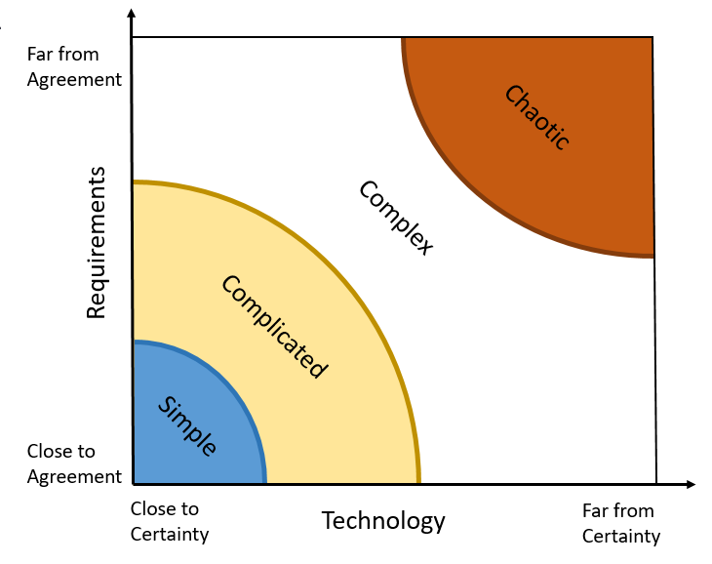
Sooo? Where are we? (Stacey Matrix)
Somewhere here

Slide 8
What is the situation? Why is a solution needed?
Currently there are no chatbot solution that the students can use to get answers to their questions in a quick and effective manner
The teacher (already quite busy because he’s a teacher) needs to take additional time to try and answer every question he receives from his students.
As the teacher is usually unable, due to time constraints, to answer every student question and with the same amount of dedication, a quite unfair situation is the result:
Some students get answered and other not (plus, varying quality of answers)
The teacher (who is the one giving grades, is already aware of some students’ weaknesses)

Slide 9
What are our expectations?
Experiment on the possibility to convert tacit knowledge into automated knowledge
Experiment on machine learning using the large amount of data available (collection of E-Mail exchanges between Students and Fredrich)
Develop an MVP (for lack of a better word) for a chatbot solution
Integrate this chatbot solution

